Slide 1

Characterizing SARS-Cov-2 Spike Protein Structure using second Vassiliev Measure
Jason Middlebrook
Department of Computing,
East Tennessee State University
Mentor, Professor Eleni Panagiotou
Department of Mathematics and SimCenter, UTC
07/29/2021

Slide 2
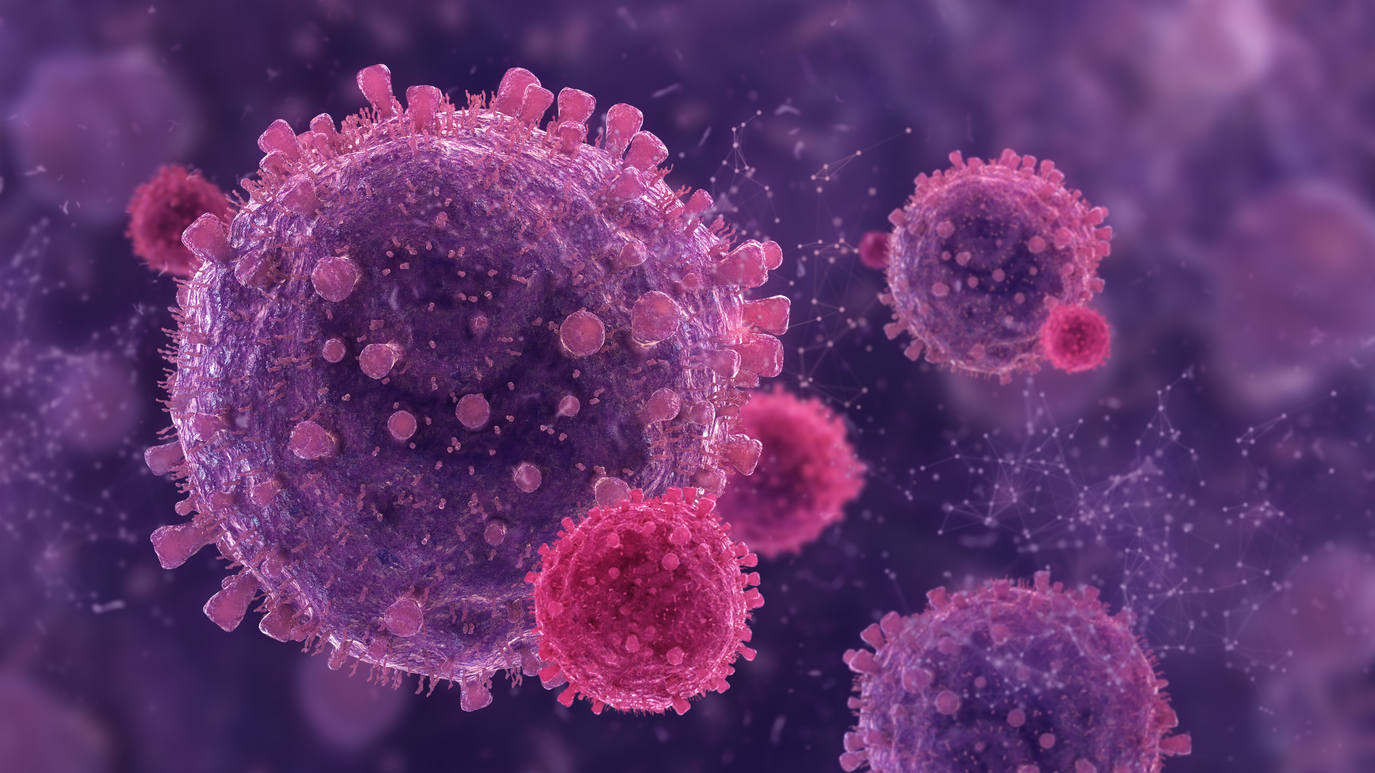
INtroduction

Slide 3
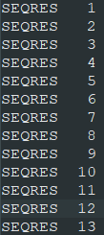
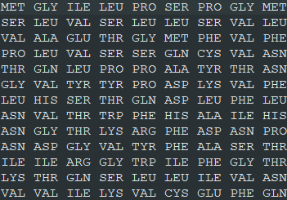
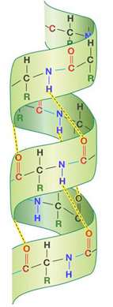
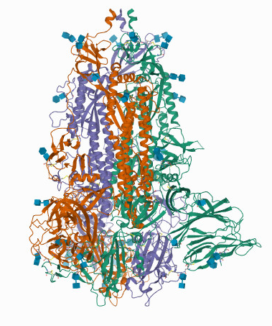
Protein Structures – 3 types
Primary structure is a protein’s amino acid sequence
Secondary structure refers to the set of 3-d shapes the protein is made up of
Tertiary structure is the 3-d conformation of the entire chain of amino acids that makes up the protein
[1]

Slide 4
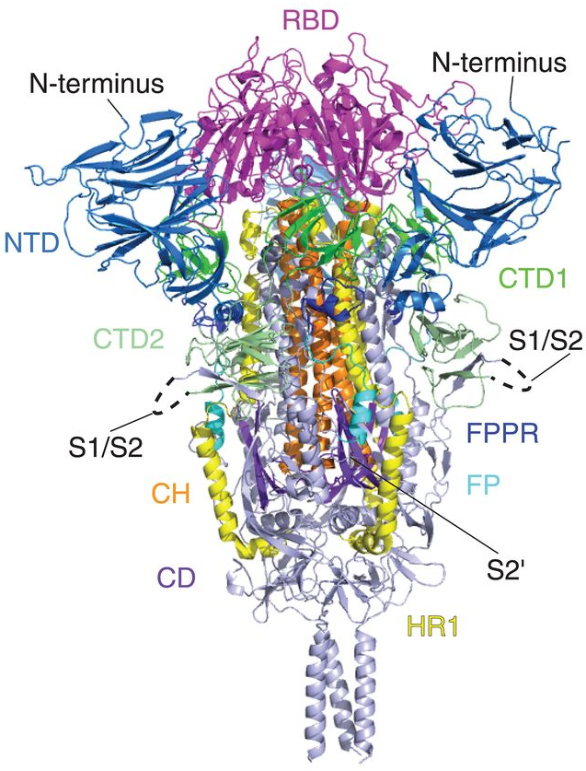
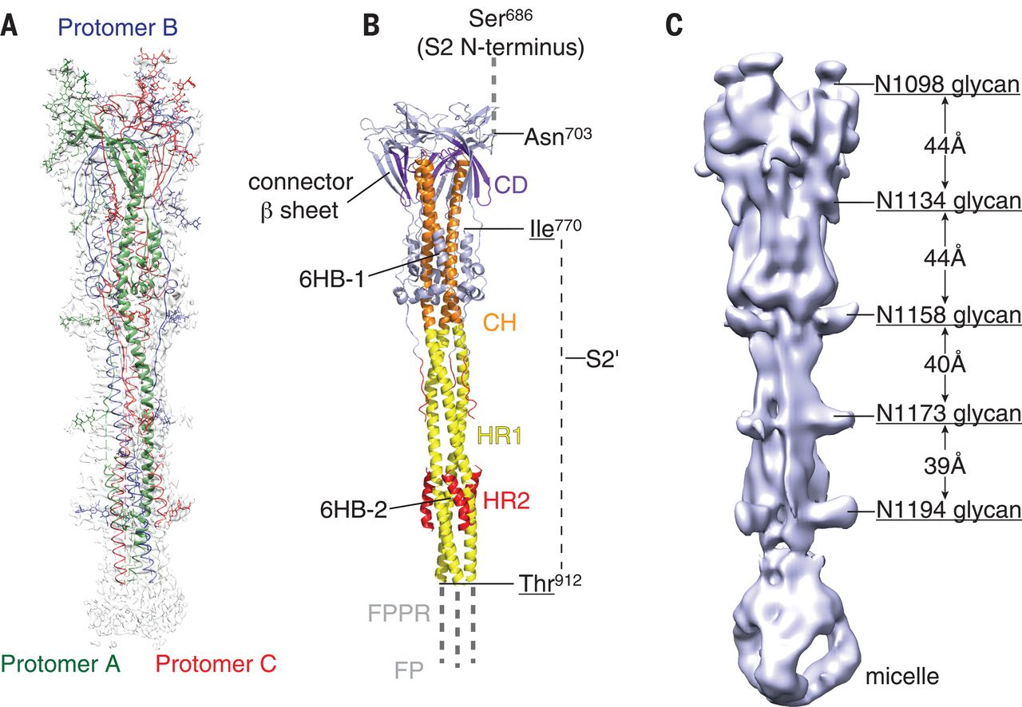
SARS-CoV-2 spike protein
Spike (S) protein binds to the human ACE2 receptor to infect cell
The Spike protein undergoes major 3-dimensional changes during the viral life cycle
[2]
Prefusion S Protein
Postfusion S Protein

Slide 5
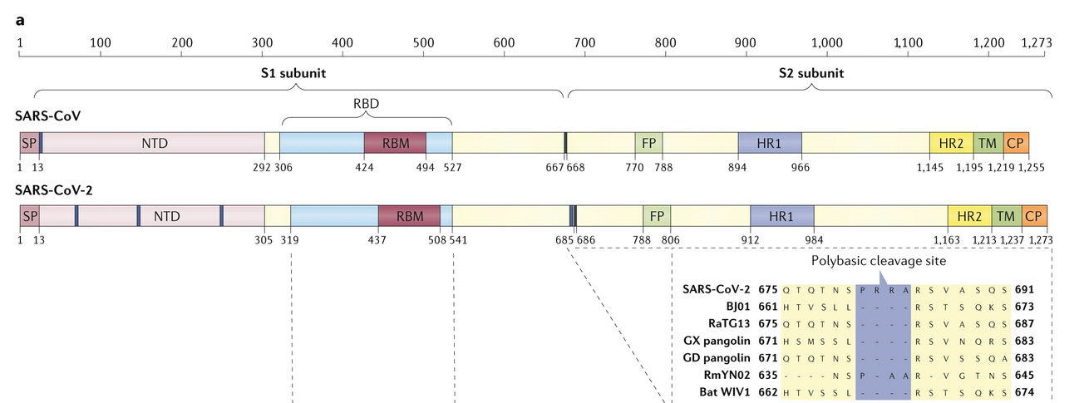
Sars-cov-2 Spike Protein Domains
Not pictured, Central Helix (CH) and Connector Domain (CD)
[3] figure 3a
S1 helps ACE2 binding
S2 helps fuse viral and human cell membranes

Slide 6
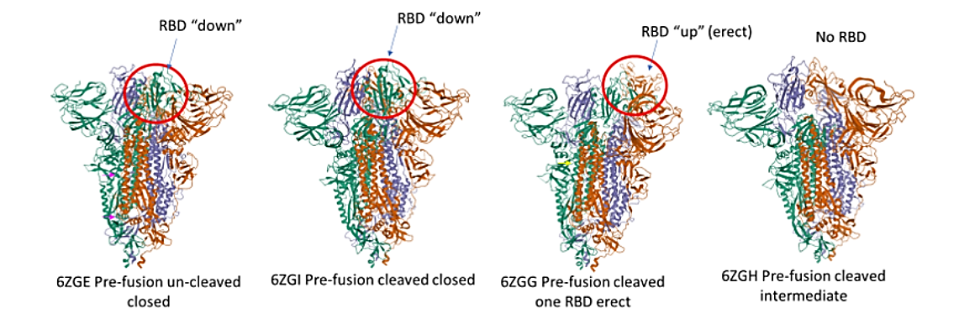
Pre-fusion structural changes of the sars-cov-2 spike protein
[4]

Slide 7
How to characterize the SARS-CoV-2 spike protein conformational changes?

Slide 8
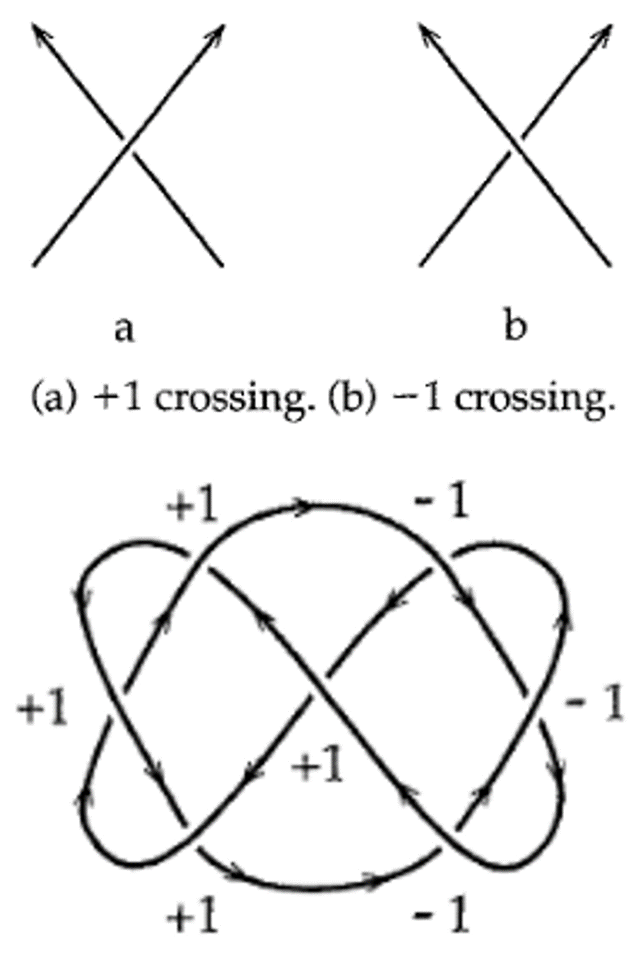
The Second Vassiliev Measure
Topology – mathematical study of knots
Second Vassiliev Measure (V2) is a topological measure for both closed and open knots
Uses combinations of alternating signed crossings to determine complexity of a diagram (a projection of a 3-dimensional curve)
[6] figures 6.6 and 6.7

Slide 9
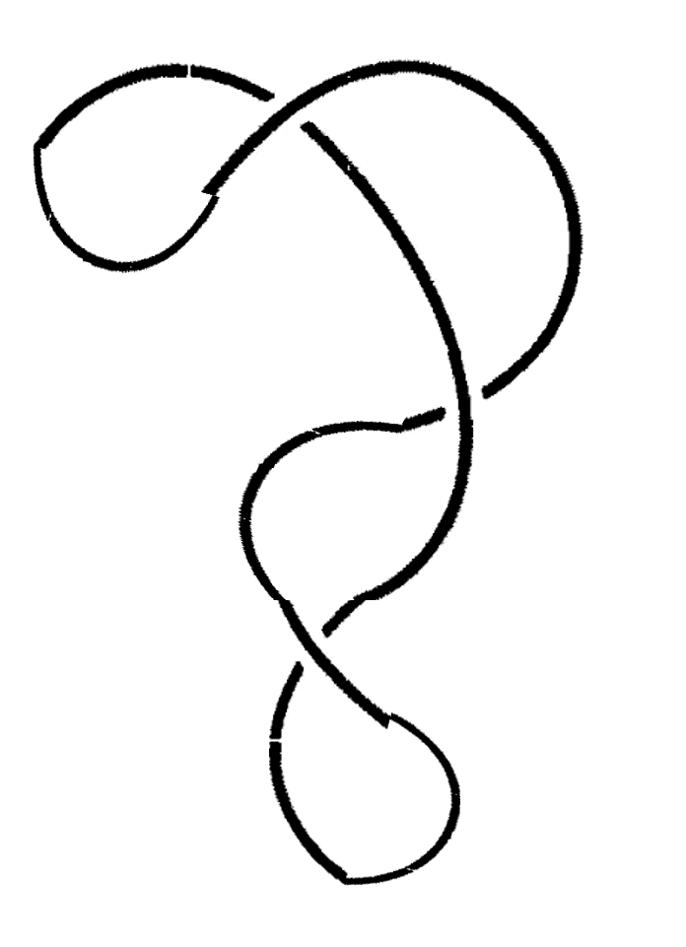
Calculating V2
IV
ii
A pair of crossings qualifies for adding to V2 if it alternates over/under
We add up all signs for qualifying sets of crossings and that is V2 for one projection
Here, we have 2 qualifying pairs of crossings. Multiply the signs and add:
V2 = -1*1 + -1*-1 = 0
+1
iii
iv
–1
I
II
III
–1
i

Slide 10
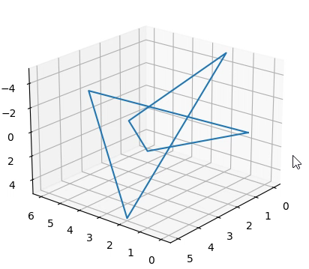
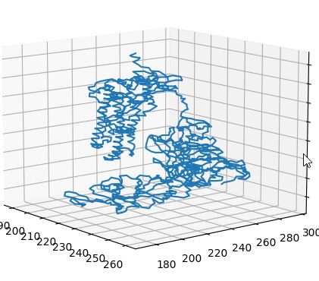
Vassiliev projections
To calculate V2 for open knots (proteins), we must use 2-d projections of the protein
We take projections onto random planes
For each projection we can calculate using the alternating signed crossings
V2 is equal to the average of this over all projection directions

Slide 11

Methods

Slide 12
Total Values Of V2 For Proteins At 100 And 1000 Projections

Slide 13
Total Values Of V2 For Proteins At 1000 And 2000 Projections

Slide 14
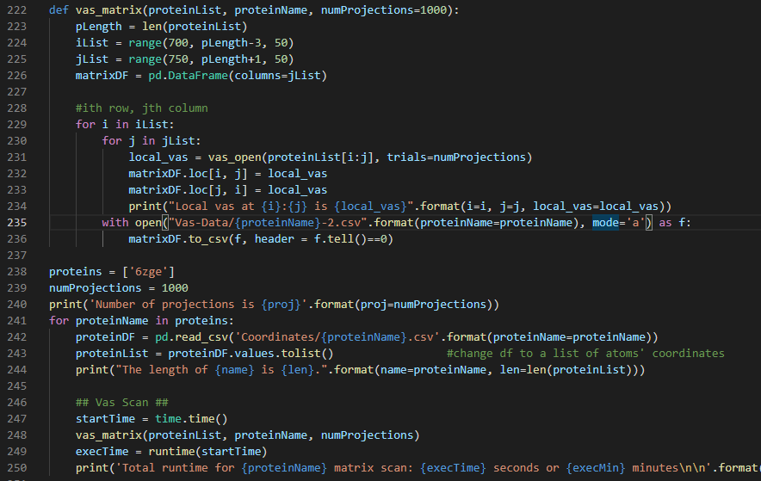
Code Example

Slide 16

Results

Slide 17
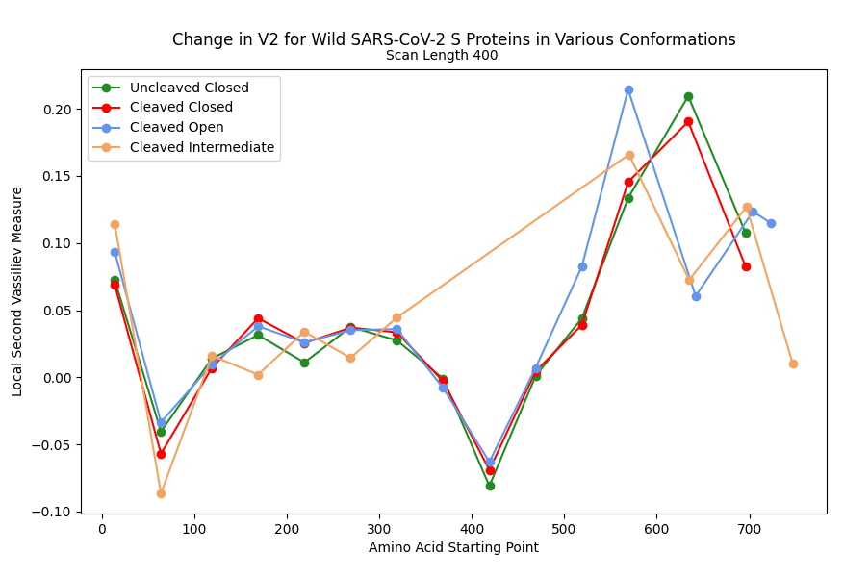
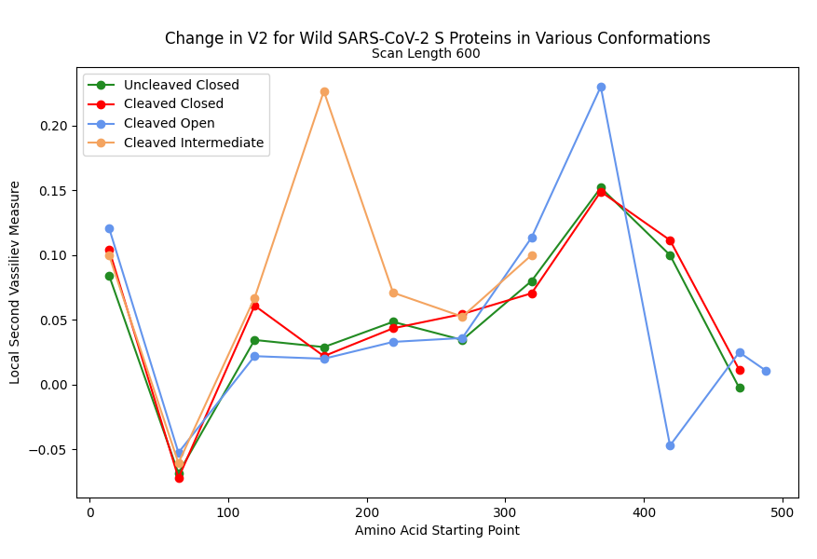
V2 along Wild SARS-CoV-2 s Proteins: 400/600 scan-lengths
These dips aren’t affected by conformation, but the peak is

Slide 18
Comparing V2 of entire protein for Closed and Open Conformations

Slide 19
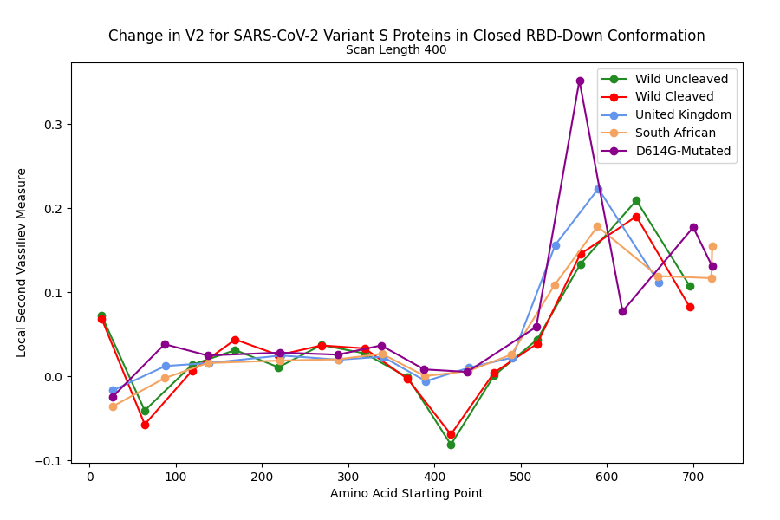
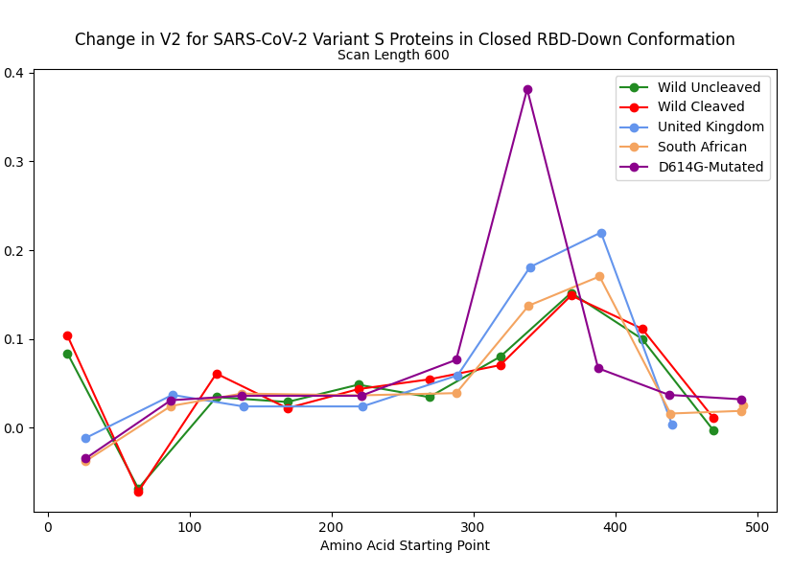
V2 along RBD-Down Proteins at 400/600 Scan-lengths
The wild type and variants have some topological differences
Dips starting at 69 and 419 are only in wild S proteins
The peak at about 370-970 has increasing intensity: wild type, SA, UK, D614G

Slide 20
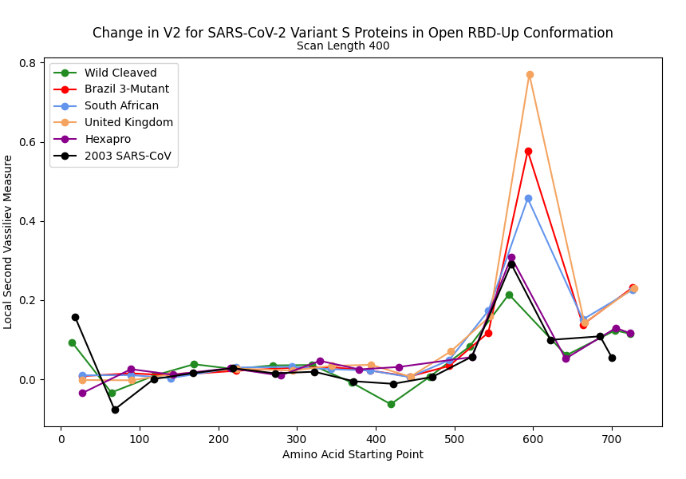
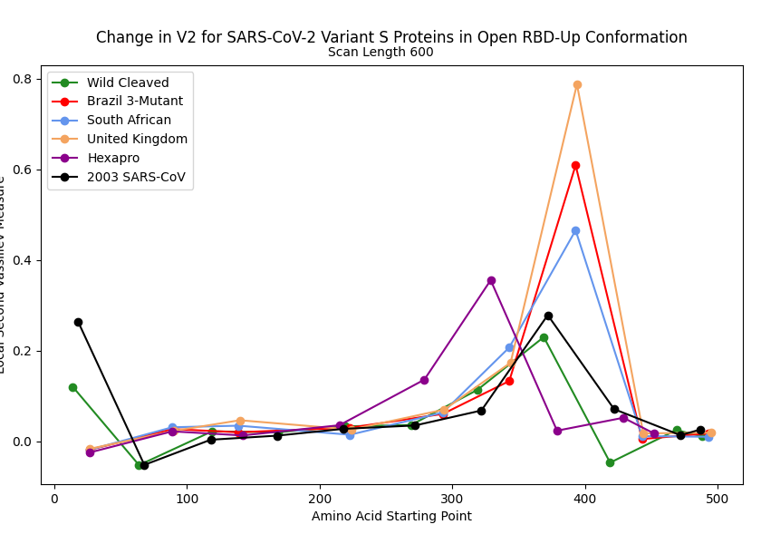
V2 along RBD-Up Proteins at 400/600 Scan-lengths
Wild has smallest peak
Peak has increasing intensity: Wild, SARS-CoV, Hexapro, SA, 3-mutant, UK
These open conformation proteins have higher V2 values at the peak

Slide 21
RBD-Up appears to increase V2 at the peak, indicating a tighter or more complex knot at peak segments
Variants also have increased V2 at peak compared to wild S proteins
We therefore suggest that increased complexity of S2 segment provides a benefit to protein fusion

Slide 22
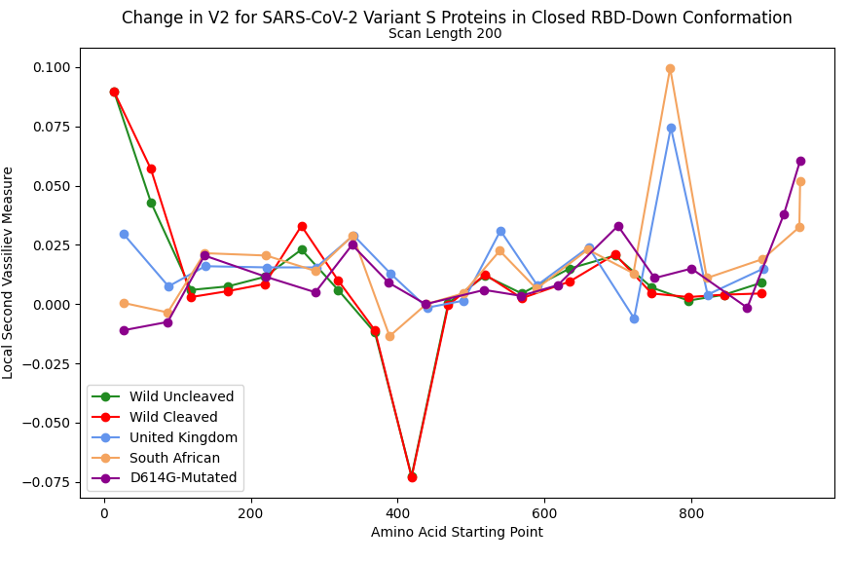
Mutations of Interest at Peak segments
Concentrated 780-980 segment also has peak for UK and SA variants
Variants’ mutations might explain higher V2 at peak segments
T716I mutation found in the UK variant is here, and the S982A and D1118H mutations are at domains HR1 and CD
CH
CD

Slide 23
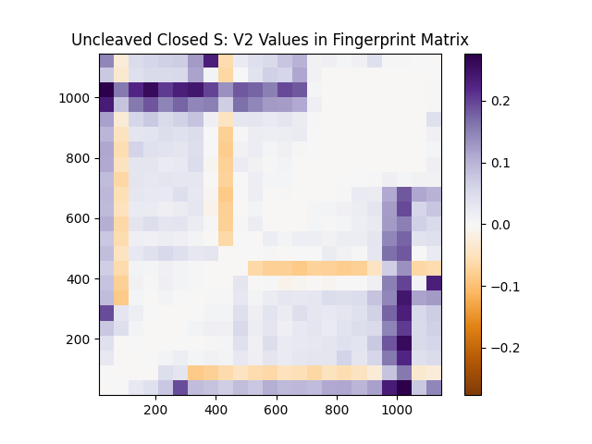
V2 Fingerprint Matrix Of The Uncleaved Closed S Protein (PDB: 6zge)
CD
CH
X- and Y-Axes are approximate starting and ending amino acids
CH
CD

Slide 24
Future Work
Create V2 fingerprints for other proteins and with more thorough scanning to aid in comparisons
More comparison of RBD conformation with changes in V2
More comparison of mutations with changes in V2 (new proteins)
Investigate if there is a benefit to more tightness/complexity at the sections ending at amino acid 1000

Slide 25


Acknowledgements
I would like to thank and acknowledge support from my mentor for the REU, Professor Eleni Panagiotou
I also acknowledge support from the NSF REU award #1852042
I would also like to thank Dr. Hong Qin and the University of Tennessee at Chattanooga.

Slide 26
References
https://cbm.msoe.edu/teachingResources/proteinStructure/primary
Cai, Y., Zhang, J., Ziao, T. et al. Distinct conformational states of SARS-CoV-2 spike protein. Science, (2020) 1586-1592.
Hu, B., Guo, H., Zhou, P. et al. Characteristics of SARS-CoV-2 and COVID-19. Nat Rev Microbiol 19, (2021) 141–154 .
Baldwin, Q., Sumpter, B.G., Panagiotou, E. The local topological free energy of the SARS-CoV-2 Spike protein. (2021) 9.
Wrobel, A.G., Benton, D.J., Xu, P. et al. SARS-CoV-2 and bat RaTG13 spike glycoprotein structures inform on virus evolution and furin-cleavage effects. Nat Struct Mol Biol 27, (2020) 763–767.
Adams, C.C. The Knot Book: An Elementary Introduction to the Mathematical Theory of Knots. (2004) 152.
S.M. Gobeil, K. Janowska, and S. and McDowell. Effect of natural mutations of sars-cov-2 on spike structure, conformation and antigenicity. Science, (2021) 1-10.

Slide 27

THANK YOU
github.com/MiddlebrookJF/iCompBio-Summer2021
MiddlebrookJF@gmail.com

